Slide 1
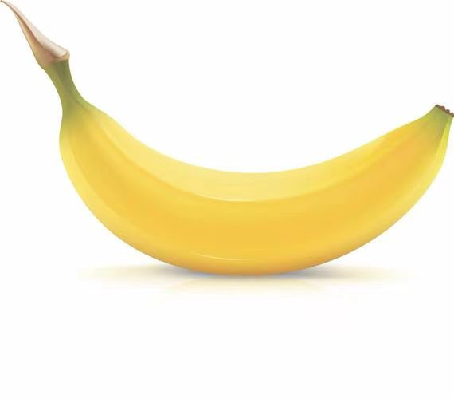
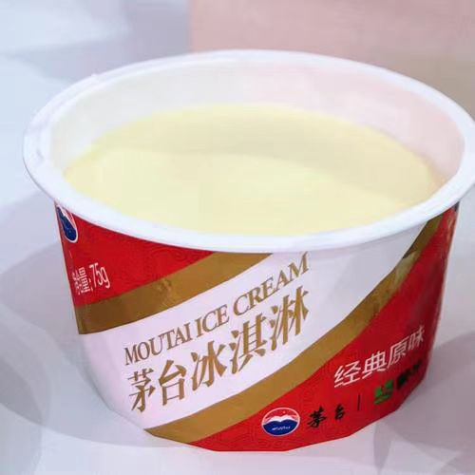
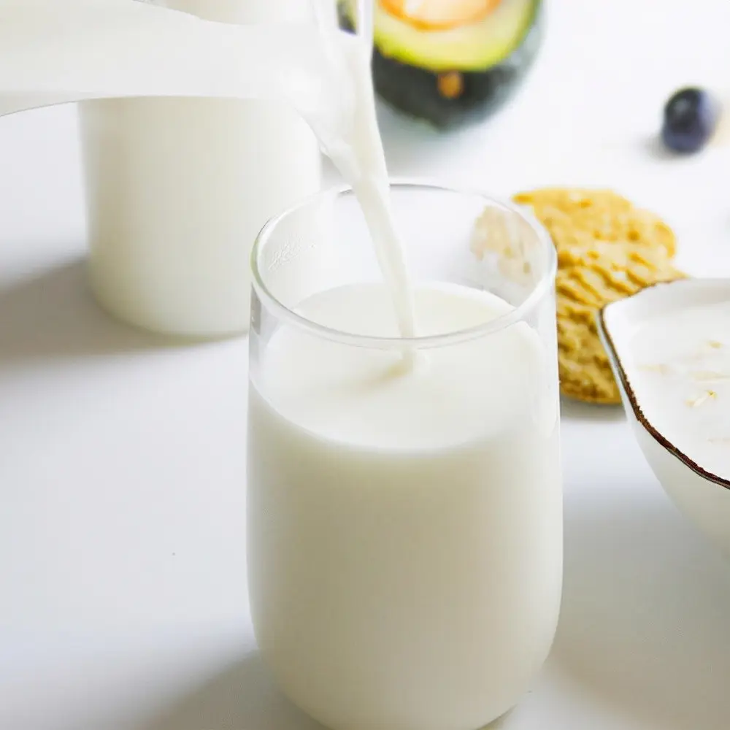
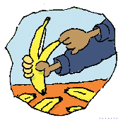
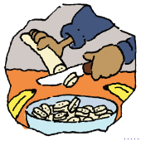
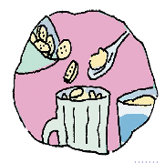
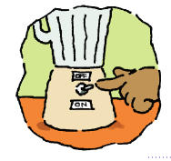
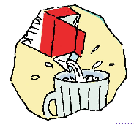
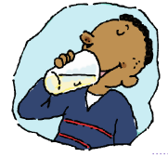
The process(过程) of making a banana milk shake.
Let’s describe the process!
ingredient原料 | banana | ice-cream/ice | milk
amount 数量
a banana an ice-crem/some ice a cup of milk
Word Bank
表达做某事的过程时，如果过程较长可用first, next, then, finally等来说明步骤，使叙述有条不紊。
first
then
next
finally
peel
cut up
put...in/into...
[piːl]
[ˈfaɪnəli]
turn on the blender
pour...into...
drink
[ˈblendə]
[pɔː]

Slide 2
Let’s make a banana milk shake and describe the process(描述过程).
ingredient原料 | banana | ice-cream/ice | milk
amount 数量
a banana an ice-crem/some ice a cup of milk
Word Bank
表达做某事的过程时，如果过程较长可用first, next, then, finally等来说明步骤，使叙述有条不紊。
first
then
next
finally
peel
cut up
put...in/into...
[piːl]
[ˈfaɪnəli]
turn on the blender
pour...into...
drink
[ˈblendə]
[pɔː]

Slide 3
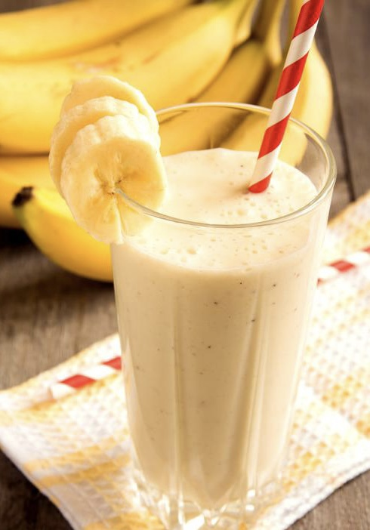
Let’s describe the process(过程) of making a banana milk shake!
First, peel ______________.
Then, cut up ______________.
Then, put ______________ in/into ______________.
Then, pour ______________ into ______________.
Next, turn on ______________.
Next, pour ______________ into ______________.
I’m finished.
7. Finally, drink ______________.

Slide 4
Let’s make a fruit salad and describe the proces(描述过程).
ingredient原料 | apple | watermelon | banana | orange | yogurt | honey | salad sauce
amount 数量
First, wash ______________.
Then, peel ______________.
Then, cut up ______________.
Then, put ______________ in ______________.
Next, pour ______________ into ______________.
Finally, mix ______________ and ______________.
I’m finished.

Slide 5

Unit 8

Slide 6
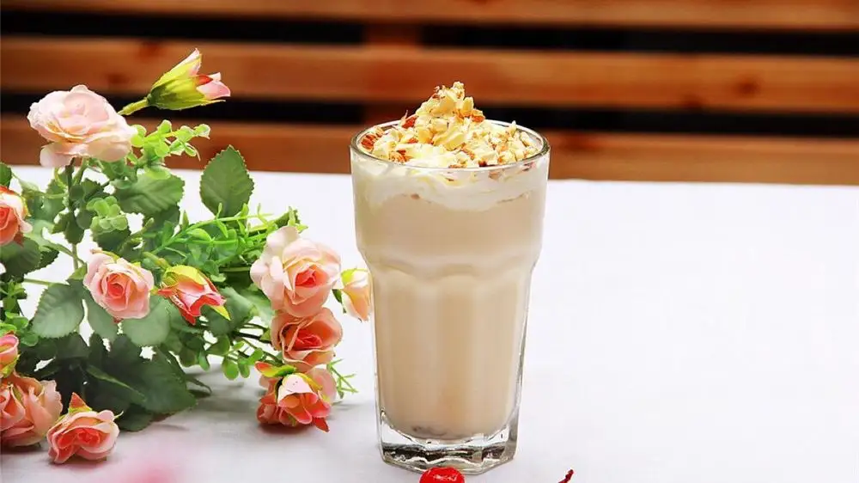
Unit 8
How do you make a banana milk shake?

Slide 7
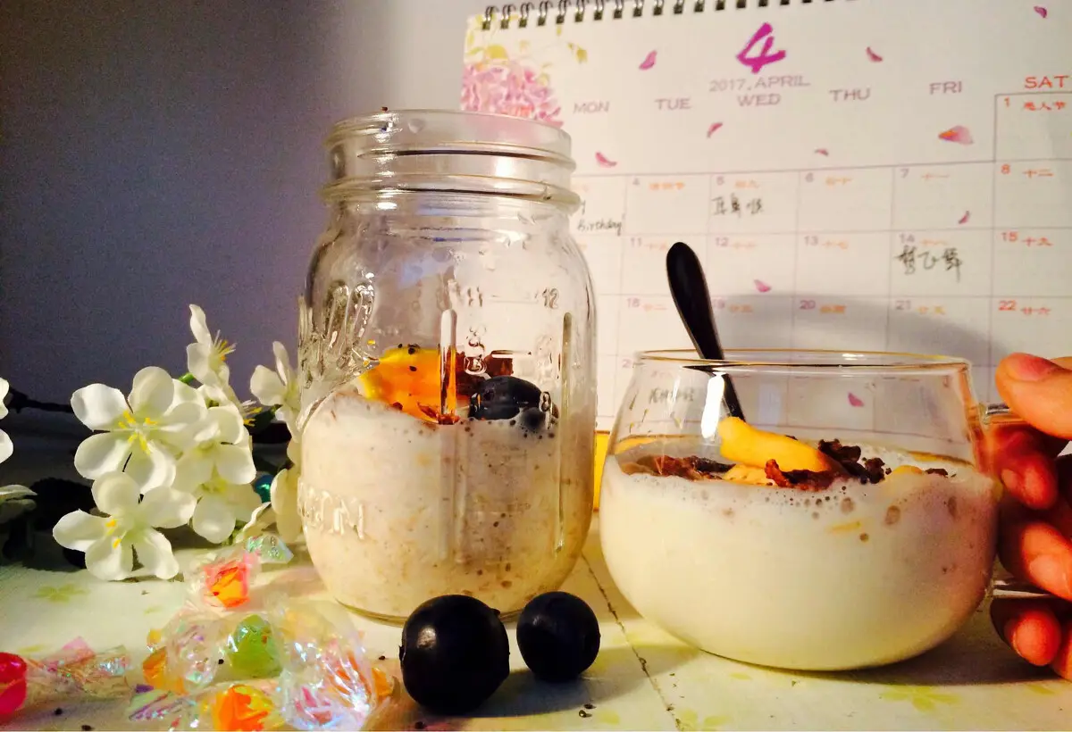


Slide 8
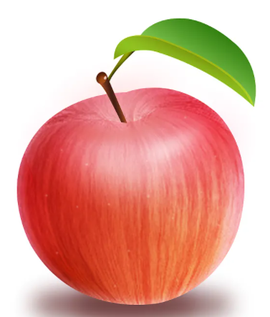
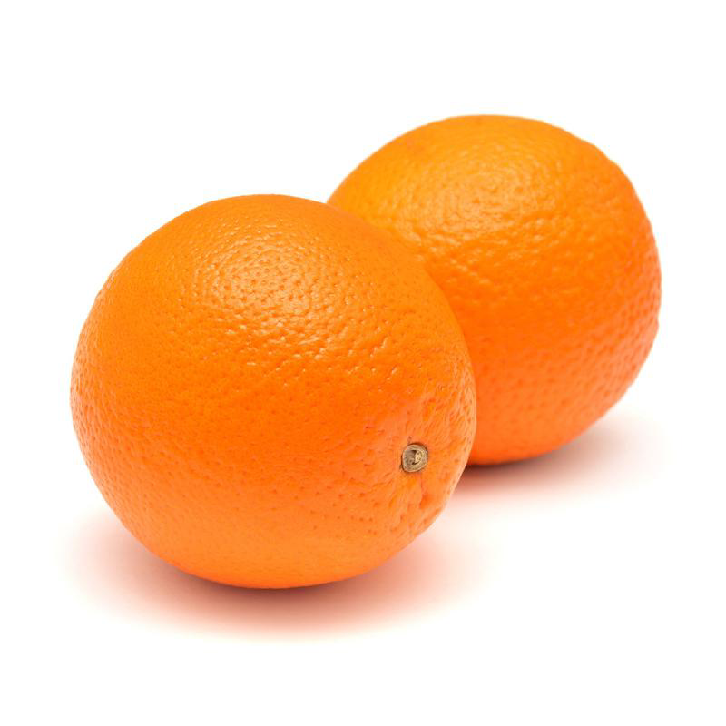
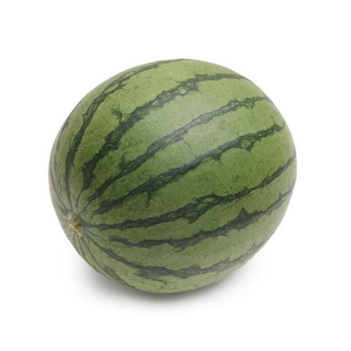
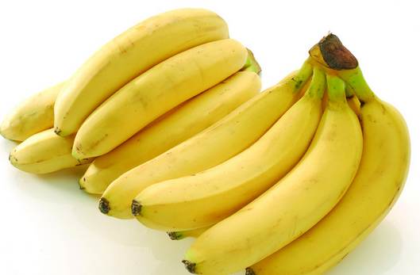
——What do you see?
——We see ...
apple
oranges
bananas
watermelon
[ˈwɔːtəmelən]

Slide 9
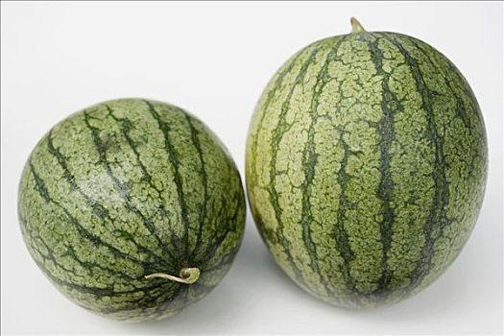
——How many ...(cn复数) do you see?
——We see ...
one/an apple
four oranges
some bananas
two watermelons

Slide 10
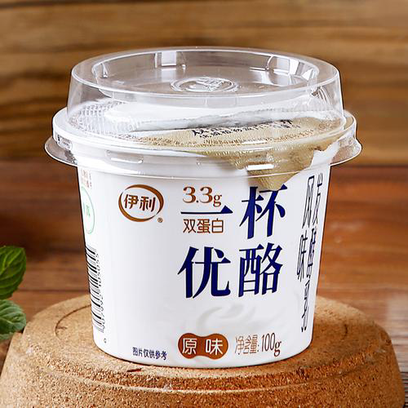
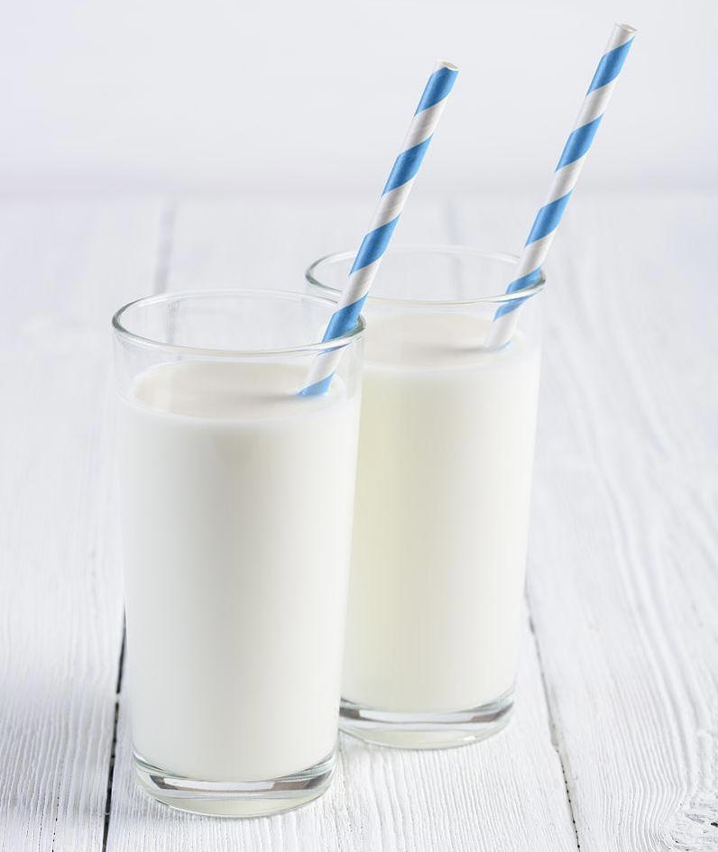
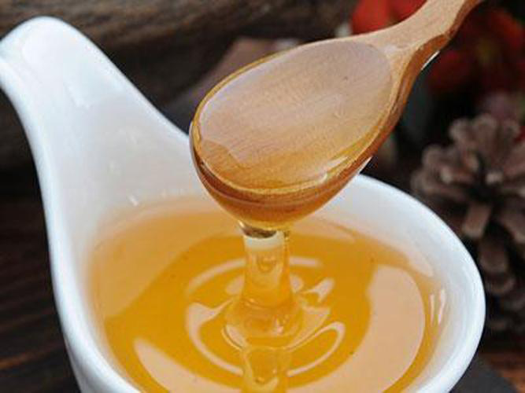
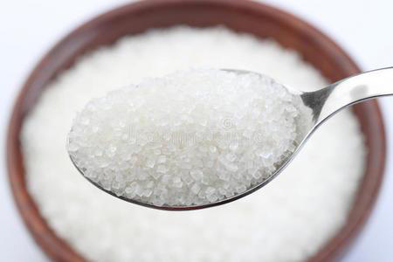
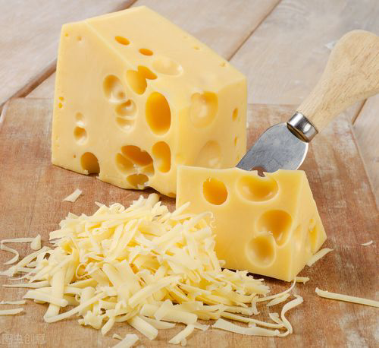
——What do you see?
——We see ...
yogurt
milk
[ˈjɒɡət]
honey
sugar
cheese
[ˈhʌni]
[ˈʃʊɡə]
[tʃiːz]

Slide 11
——How much ...(un) do you see?
——We see ...
a cup of yogurt
two cups of milk
a spoon of honey
a spoon of sugar
some cheese
[spuːn]

Slide 12
a banana milk shake
How do we make ?
[ʃeɪk] n.奶昔
Milk shake is a cold drink made by mixing milk with fruit, ice or ice-cream.
[miks] v.混合;融合

Slide 13
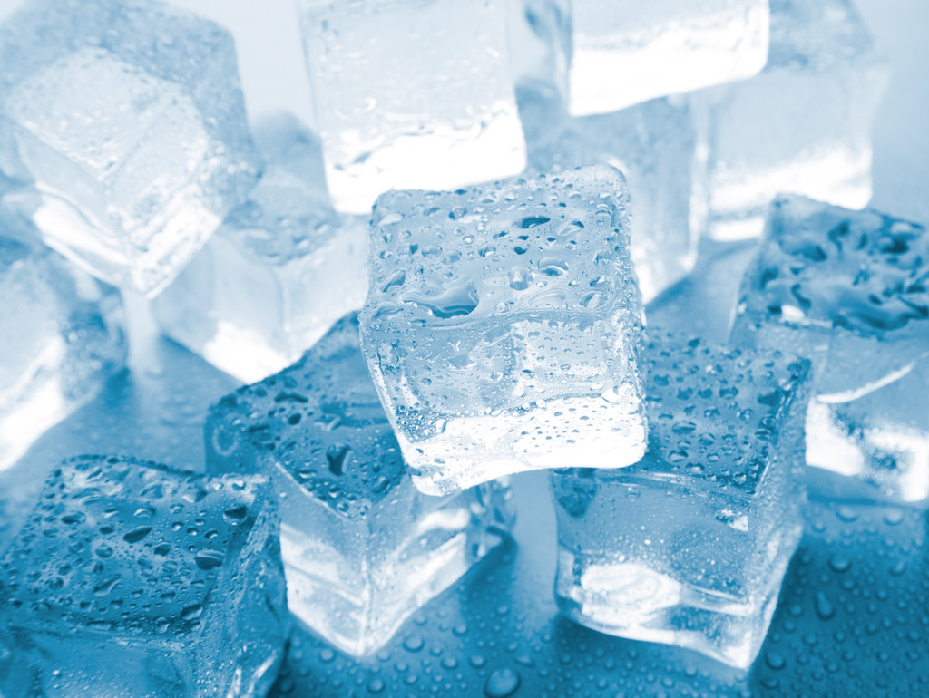
The ingredients(原料) and process(过程) of making a banana milk shake.
——How many/much ... do we need?
——We need ...
ingredient原料 | banana | ice-cream/ice | milk
amount 数量
a banana an ice-crem some ice a cup of milk
Word Bank
blender
[ˈblendə]
peel
put...in/into...
turn on ...
[piːl]
cut up
pour...into...
[pɔː]
drink

Slide 14


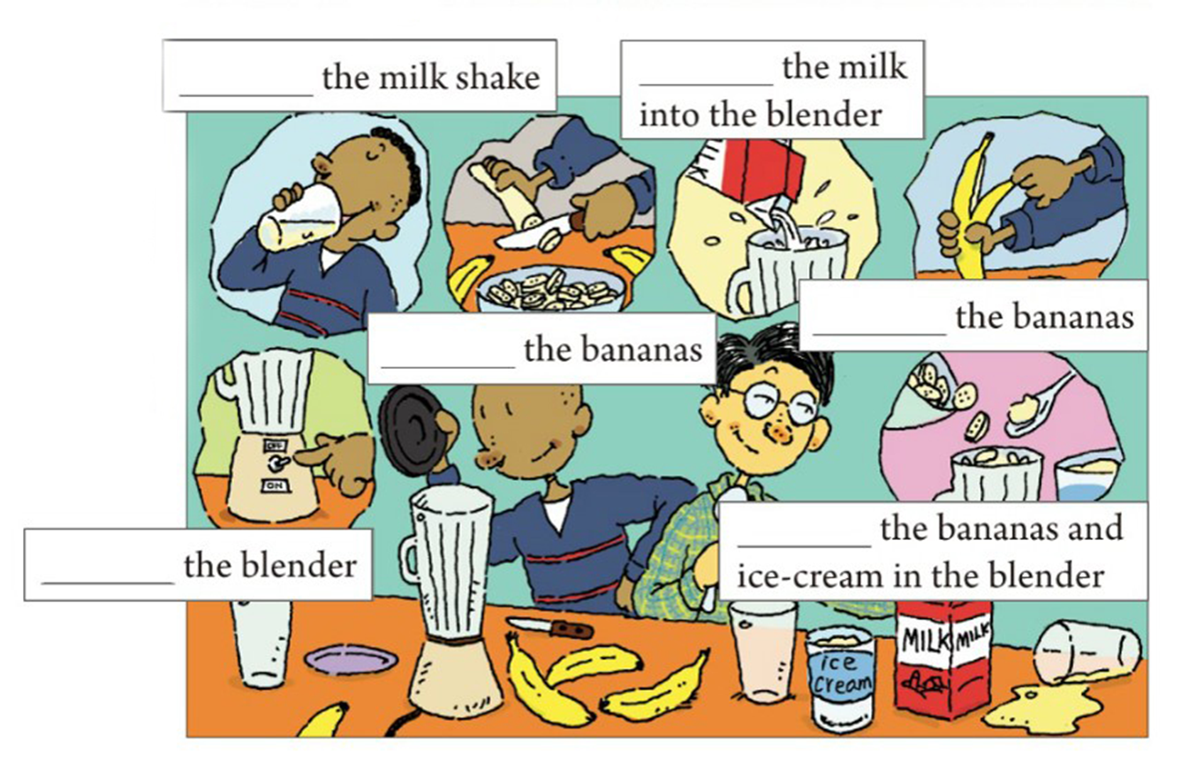
How do you make a banana milk shake?
Write these words in the blanks in the picture.
turn on cut up drink peel pour put

Slide 15
pour
drink
peel
cut up
put
turn on

Slide 16
Let’s describe the process(过程) of making a banana milk shake!
表达做某事的过程时，如果过程较长可用first, then, next, finally等来说明步骤，使叙述有条不紊。
First, peel one banana.
Then, cut up the banana.
Then, put the bananas and an ice-cream(some ice) in/into the blender.
Then, pour a cup of milk into the blender.
Next, turn on the blender.
Next, pour the milk shake into a glass. I’m finished.
Finally, drink the milk shake.

Slide 17
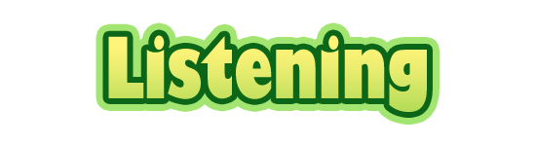


Listen and put the instructions(指示/用法说明) in order.
_____ Turn on the blender.
_____ Cut up the bananas.
_____ Drink the milk shake.
_____ Pour the milk into the blender.
_____ Put the bananas and ice-cream in the blender.
_____ Peel three bananas.
5
2
6
4
3
1

Slide 18
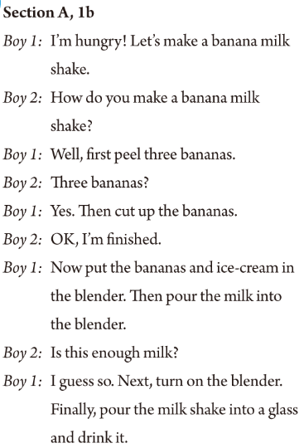
Let’s read.

Slide 19
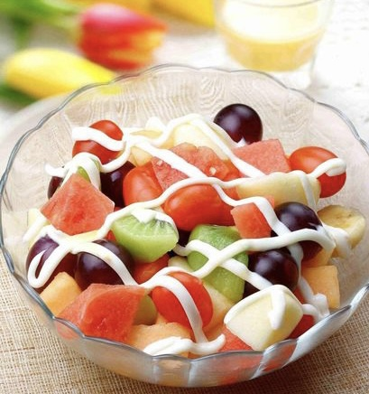
——What do you see?
——We see ...
How do we make a fruit salad?
a fruit salad
水果沙拉: 将不同的水果切成丁状/方块，摆放在盘子里，浇上配酱(如沙拉酱 /酸奶 /蜂蜜等)，进行搅拌就完成了。

Slide 20


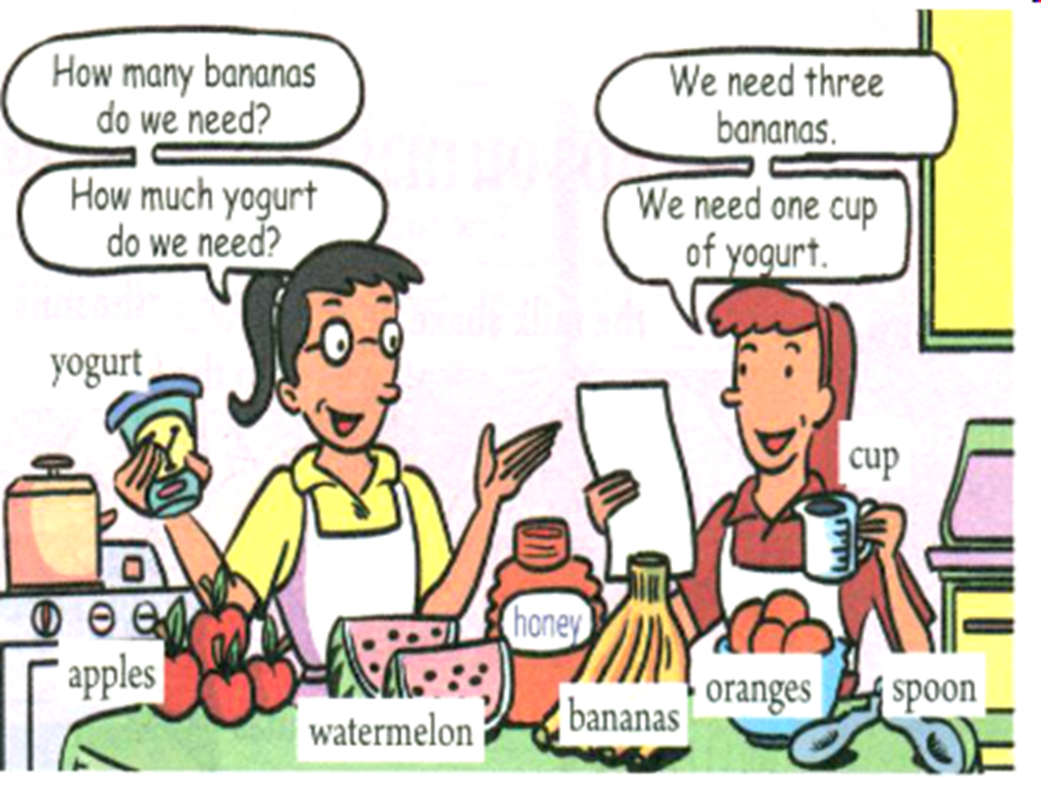
Look at the picture about the ingredients(原料) of making a fruit salad. What are they? Complete the chart with the ingredients.
How many | bananas,
How much | yogurt,
watermelons,
apples,
oranges
honey

Slide 21

Listen to the conversation about making a fruit salad.
Write the ingredients(原料) under the correct amount(数量) in the chart.
one | two | three | one cup | two spoons
watermelon
apples
bananas
yogurt
honey
orange

Slide 22
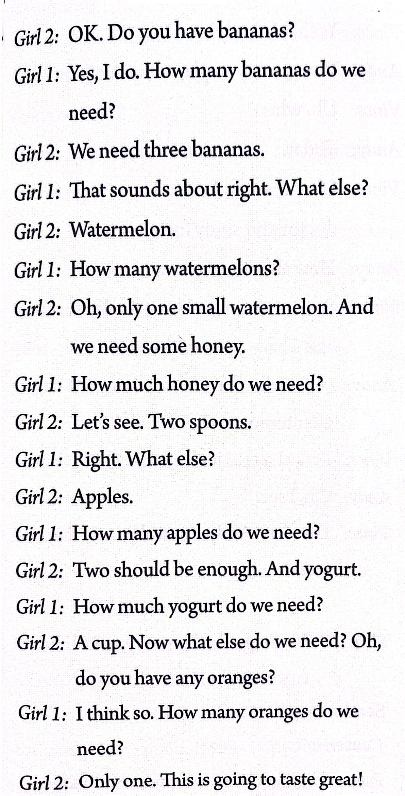
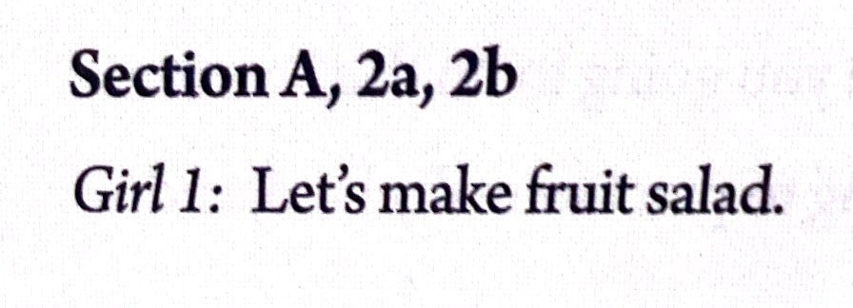

Slide 23
The ingredients(原料) and process(过程) of making a fruit salad.
ingredient原料 | apple | watermelon | banana | orange | yogurt | honey
amount 数量
2 1 3 1 one cup two spoons
the fruit
First, wash ______________.
Then, peel ______________.
Then, cut up ______________.
Then, put ______________ in ______________.
Next, pour ______________ into ______________.
Finally, mix ______________ and ______________.
the fruit
the fruit
the fruit a bowl
one cup of yogurt and two spoons of honey
the fruit
the fruit
the yogurt and honey

Slide 25
Complete the conversation.
G1: Let’s make ___________.
G2: OK. Do you have _________?
G1: Yes, I do. ___________ bananas do we need?
G2: We need three bananas.
G1: That sounds about right. What else?
G2: ____________.
G1: __________ watermelons?
G2: Oh, only one small watermelon. And we need some honey.
fruit salad
bananas
How many
Watermelon
How many

Slide 26
G1: __________ honey do we need?
G2: Let’s see. Two _______.
G1: Right. What else?
G2: ________.
G1: __________ apples do we need?
G2: Two should be enough. And ________.
G1: __________ yogurt do we need?
G2: _________. Now what else do we need? Oh, do you have any oranges?
G1: I think so. ___________ oranges do we need?
G2: Only one. This is going to taste great!
How much
spoons
Apples
How many
yogurt
How much
A cup
How many

Slide 27
Look at the pictures and listen again. This time you can check your answers.

Slide 28
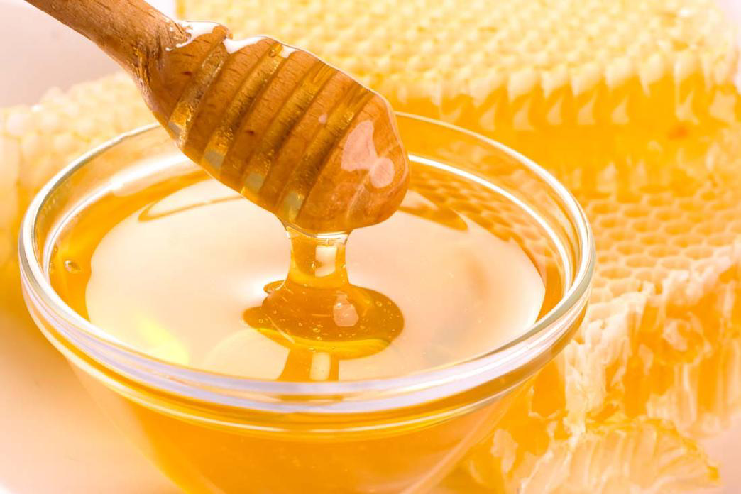
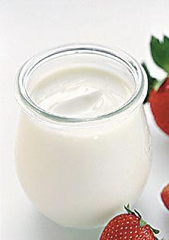
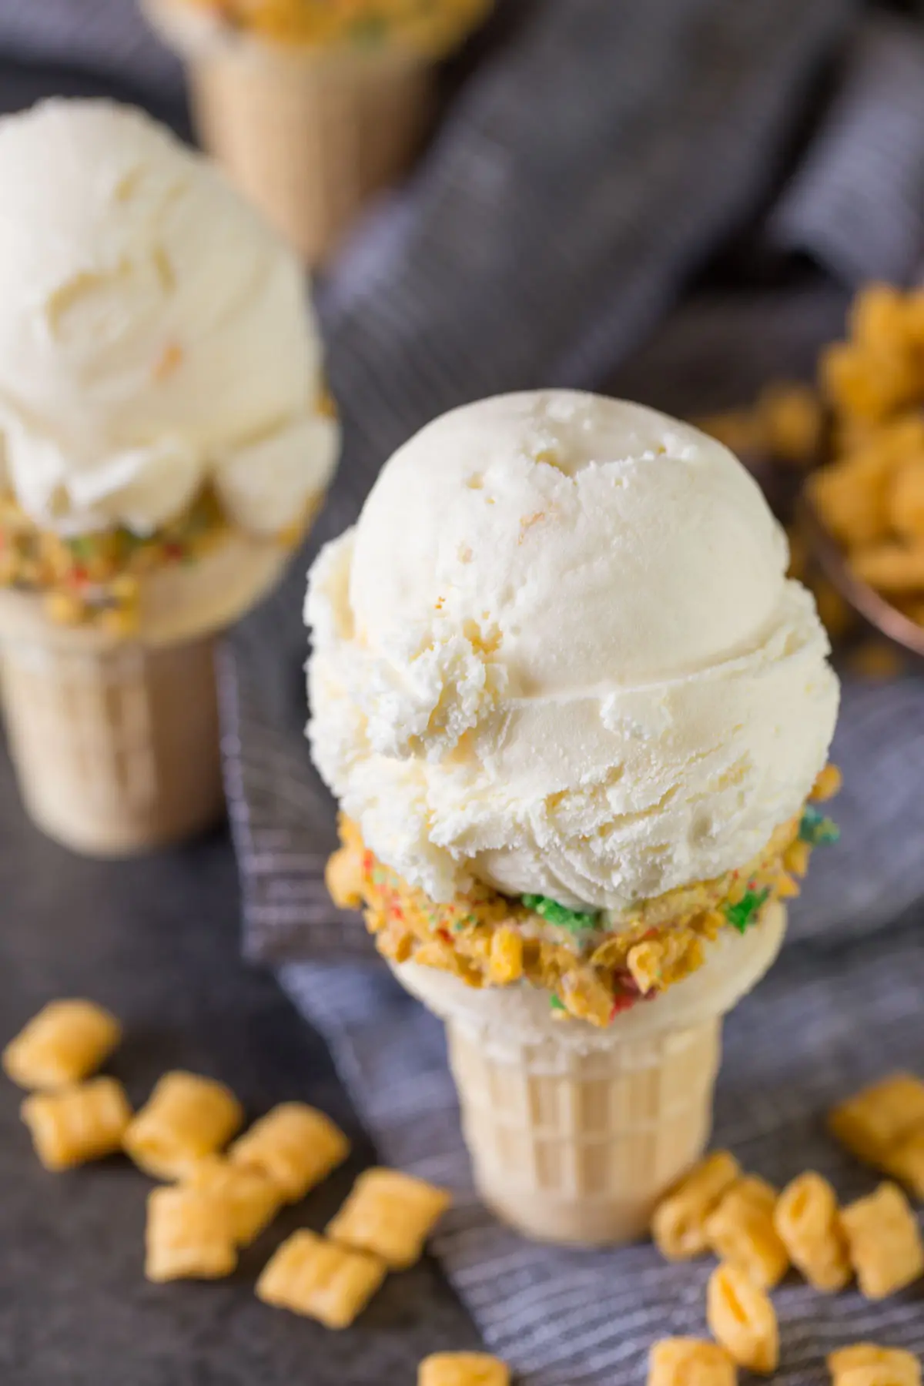
祈使句: 此处表达说话者的要求。
接通(电流、煤气、水等); 打开
v. 剥皮；去皮
v. 倒出; 倾倒
finally
adv. 最后; 最终

Slide 29



To learn to describe a process of making food:
First … Next … Then … Finally …
To learn to follow the instructions
To learn to use how many & how much
To learn new words and phrases: shake, turn on, pour, yogurt, honey, watermelon, spoon, add, finally, salt…

Slide 30


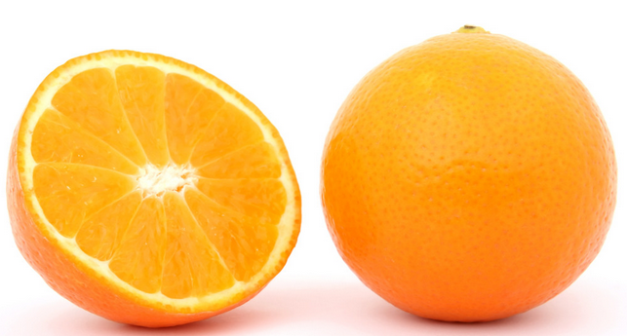
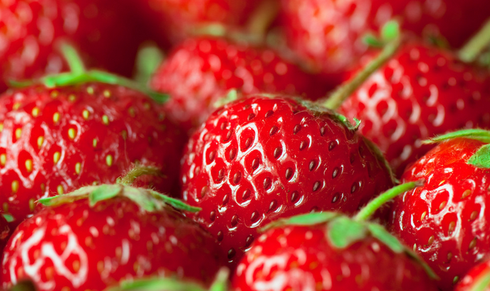
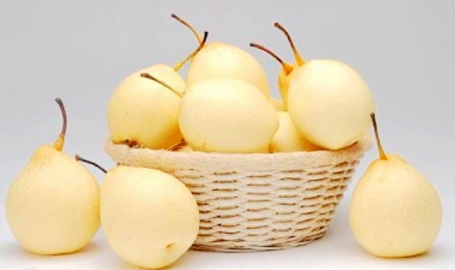
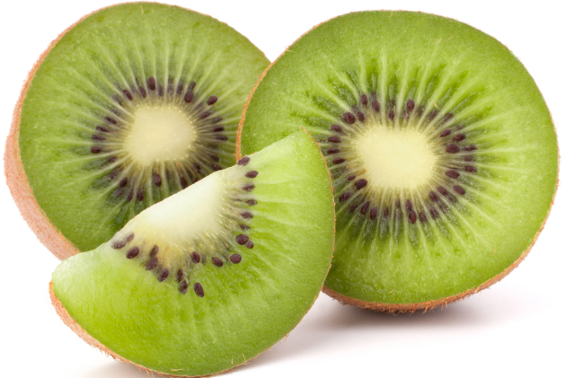
What’s your favorite fruit?
apple
orange
strawberry
banana
pear
kiwi

Slide 31
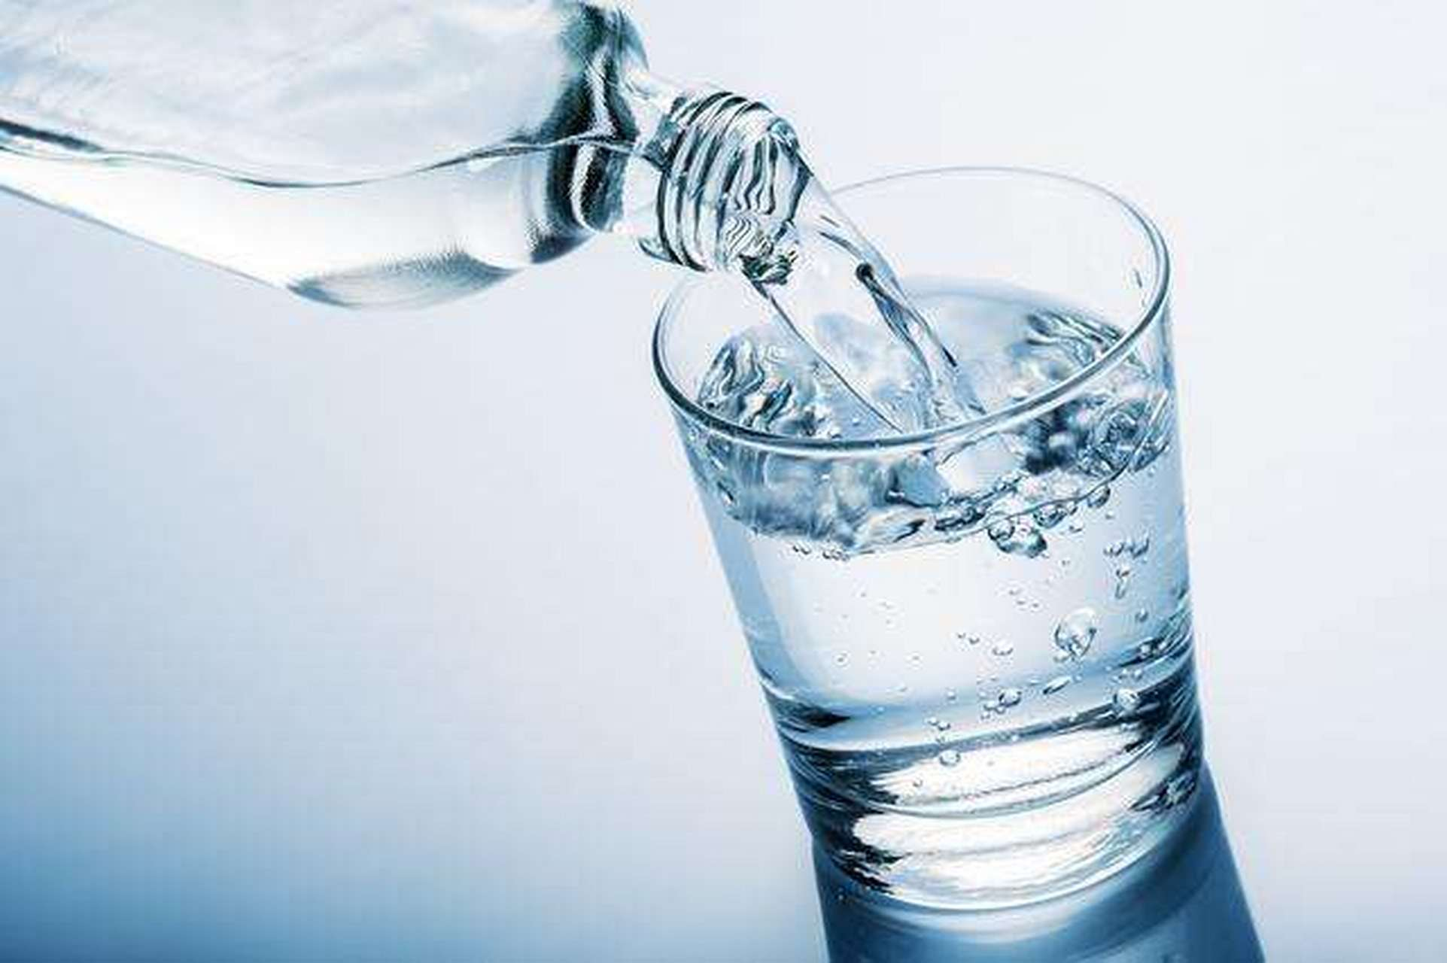
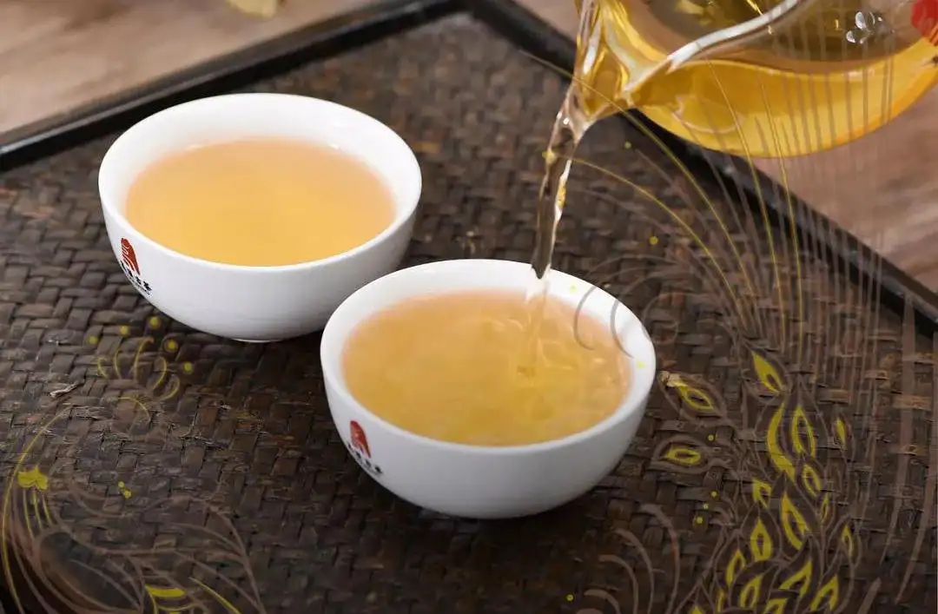
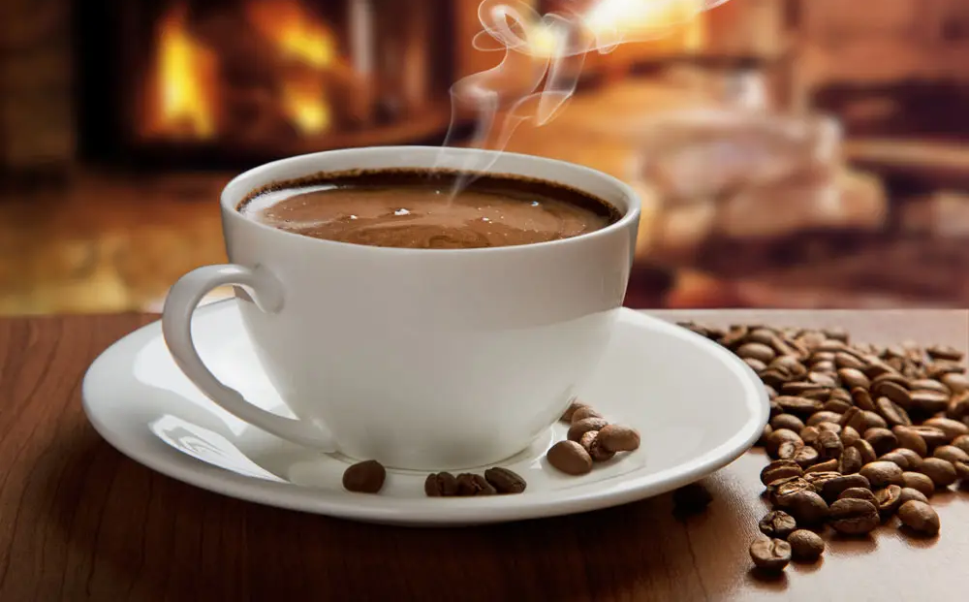
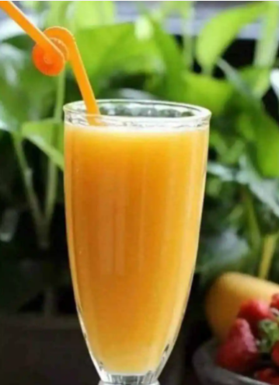
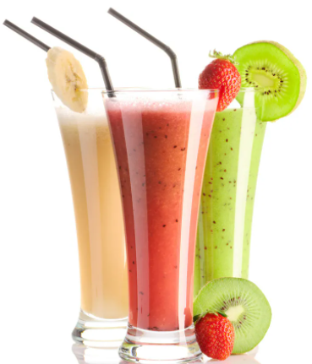
What’s your favorite drink?
water
tea
coffee
奶昔(由牛奶和冰淇淋等搅制而成的混合饮料)
milk
juice
milk shake

Slide 32
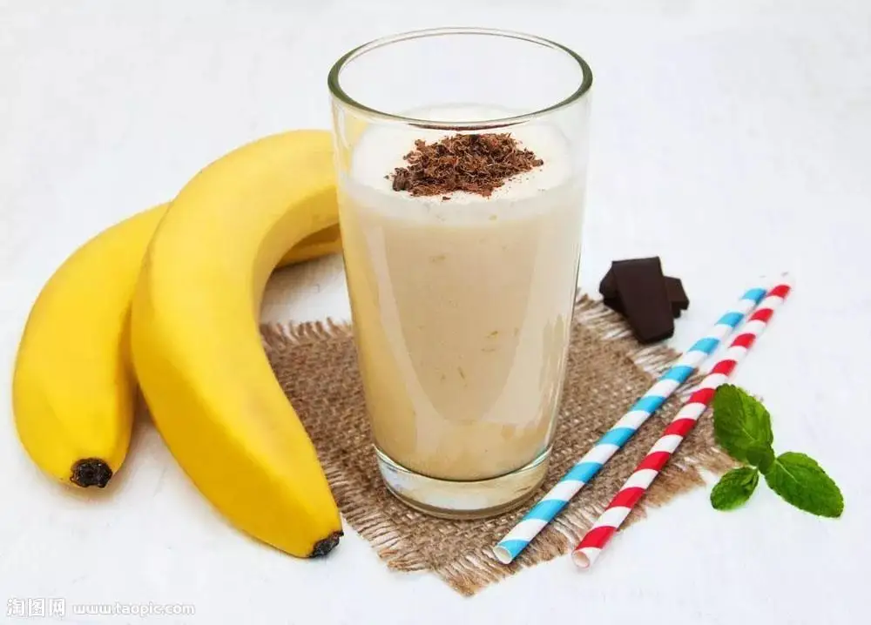
Do you like milk shake? Do you know how to make a banana milk shake?
n. & v. 摇动; 抖动

Slide 33
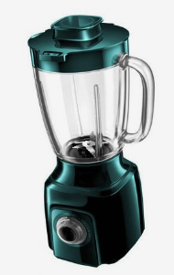
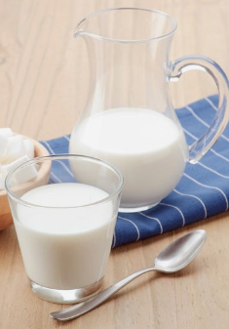
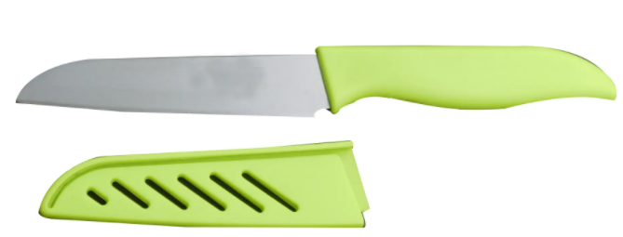
What do we need?
ice-cream
blender
milk
n. 食物搅拌器
banana(s)
knife

Slide 34

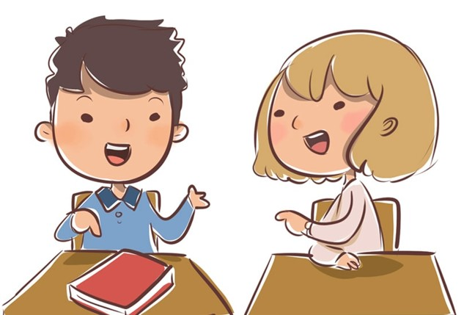
Cover the instructions above. Tell your partner how to make a banana milk shake.
First, peel the bananas…
Then, cut up…
Then, …
Next, …
Finally, …
How do you make a banana milk shake?

Slide 35

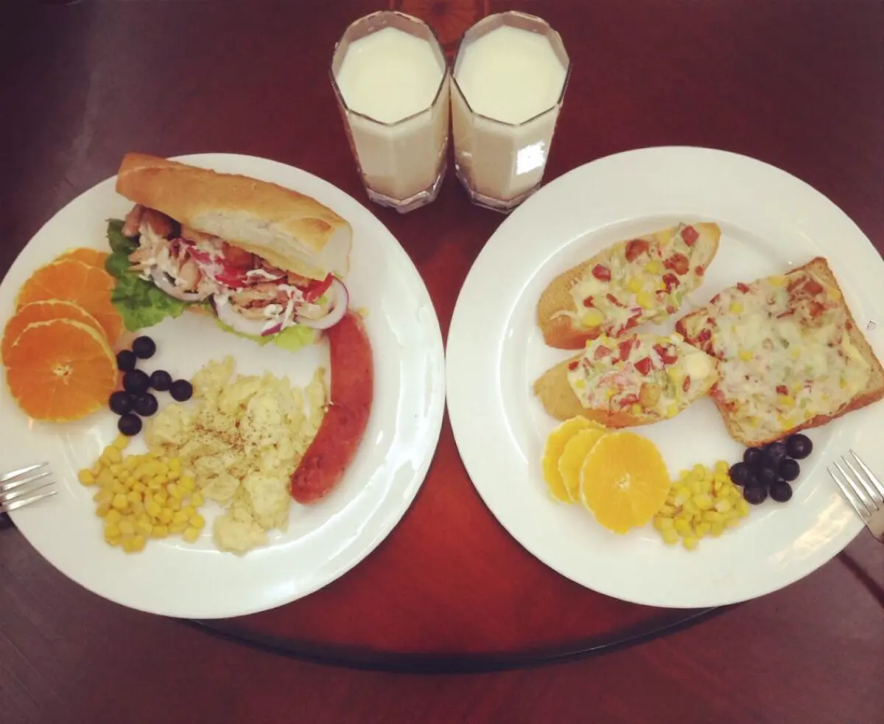
What did you have for breakfast?
How much/many _______ did you eat/drink?
如:
a cup of
two spoons of
three pieces of
n.勺; 调羹

Slide 36
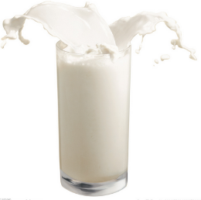
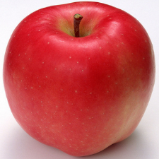

Countable noun(可数名词)
____ apple
an
glasses of
two _________ milk
Uncountable noun (不可数名词)
Uncountable noun (不可数名词)
pieces of
ten _________ bread

Slide 37


可数名词复数形式的构成 I
名词特点 | 词尾加法 | 词尾读音方法 | 例词
一般情 况下
1. -s在清辅音后读/s/
desks
加-s
2. -s在浊辅音后读/z/
apples
3. -s在元音后读/z/
pears
以-s, -x, -sh, -ch 结尾的
classes
dishes
加-es
4. 以音素
结尾的，读/Iz/
oranges

Slide 38

可数名词复数形式的构成 II
名词特点 | 词尾加法 | 词尾读音方法 | 例词
以辅音字母加y结尾的
改y为i 再加-es
families
-ies读/Iz/
dictionaries
以元音字母加y结尾的
加-s
-s读/z/
boys
keys
以“f或fe”结尾的
变f或fe为v,再加-es
-ves读/vz/
knives

Slide 39









a bottle of
a can/tin of
a spoon of
a cup/glass of
a bar of
a loaf of
a bag of
a drop of
不可数名词要表示确切的数量时，则用“数词 + 表示量的名词(单/复数) + of + 不可数名词”结构，如：three bottles of yogurt
n.酸奶

Slide 40

Look at the picture and think about the rule.
*对可数名词数量提问，疑问词要用 how many。
*对不可数名词数量提问，要视具体情况而定：
1)若对不可数名词提问， 疑问词用how much；如：How much milk …?
2)若对修饰不可数名词的量词的数量进行提问， 疑问词用how many。如：How many cups of tea …?

Slide 41
Listen and complete the chart.
n. 西瓜
How many | bananas,
How much | yogurt,
watermelons,
apples,
oranges
honey
n. 蜂蜜

Slide 42
Listen again. Write the ingredients under the correct amount in the chart.
one | two | three | one cup | two spoons
watermelon,
apples
bananas
yogurt
honey
orange

Slide 43
Complete the conversation.
G1: Let’s make ___________.
G2: OK. Do you have _________?
G1: Yes, I do. ___________ bananas do we need?
G2: We need three bananas.
G1: That sounds about right. What else?
G2: ____________.
G1: __________ watermelons?
G2: Oh, only one small watermelon. And we need some honey.
fruit salad
bananas
How many
Watermelon
How many

Slide 44
G1: __________ honey do we need?
G2: Let’s see. Two _______.
G1: Right. What else?
G2: ________.
G1: __________ apples do we need?
G2: Two should be enough. And ________.
G1: __________ yogurt do we need?
G2: _________. Now what else do we need? Oh, do you have any oranges?
G1: I think so. ___________ oranges do we need?
G2: Only one. This is going to taste great!
How much
spoons
Apples
How many
yogurt
How much
A cup
How many

Slide 45




Ask and answer questions about how to make fruit salad.

Slide 46

Use the questions to talk about your eating habits.
Which of the following do
we need every day?
Foods Drinks Fruits
rice tea apples
bread coffee oranges
hamburgers milk …
tomatoes …
…
What food do you need every day?
How many/much do you need?
What fruit do you need every day?
How many do you need?
…

Slide 47



1. Cut up the bananas.
cut up 切碎
e.g. Help me cut up the onion.
帮我切一下洋葱。
Cut up the vegetables.
把蔬菜切碎。
【语境应用】单项选择。
— Alice, could you help me ______
the meat? I want to make some
dumplings for dinner.
— OK. I’ll do it right away.
A. put up B. give up
C. use up D. cut up

Slide 48
2. Turn on the blender. 打开食物搅拌器。
turn on 打开
e.g. turn on the gas(煤气) / computer / TV / radio / light(灯)
反义词组是 turn off
注意：
如果其宾语为名词(短语)时，该名词(短语)位于turn on后面或者turn与on之间；如果其宾语为代词时，该代词应位于turn 与on之间。
e.g. Don’t turn on the blender / turn the blender on now.
I want to watch TV. Could you please turn it on?

Slide 49
【链接】
open也可表示“打开”，通常指将原来关上或合上的东西打开，如open the door (门) / window (窗户) / book等，其反义词是close (合上)。
【拓展】
turn up 调高音量；露面
turn down 调低音量；拒绝
turn to sb. 向某人求助
turn around 转身；翻转

Slide 50
【语境应用】完成句子。
1) I want to watch TV. Please help me ______________ (打开它).
2) Andy ___________________________ (打开他的电脑) and sent an e-mail to his friend.
3) Can I _____________________ (打开这些窗户)? It's hot.
4) 我听不清收音机里在说什么。你可以把它的声音调高点吗？
I can’t hear clearly what the radio is saying. Can you ___________________?
(to) turn it on
turned on his computer/
turned his computer on
open these windows
turn it up

Slide 51
3. Then, add the cabbage, tomatoes and onion and cook for another 10 minutes.
然后加入卷心菜、西红柿和洋葱，再煮上10分钟。
此句为祈使句。
add v. 增加; 添加
【拓展】
add ... to ... 把……加到……
e.g. 你应该往锅里加点水。(翻译)
You should add some water to the pot.

Slide 52

another adj. 还; 再; 又
another 用于具体的数字之前, 表示一种 “追加”的功能，意为 “另一个; 再追加一个”。
another + 数词 + 可数名词复数形式
= 数词 + more + 可数名词复数形式
e.g. 我又吃了两个苹果。(翻译)
I ate another two apples.
= I ate two more apples.

Slide 53
【语境应用】根据汉语意思完成英语句子, 每空一词。
1) 你想把你的名字加到名单上吗？
Do you want to _____ your name _____ the list?
2) 他又跟我们一起多住了五天。
He stayed with us for ________ ______ _______.
add to
another five days
/ five more days

Slide 54


接通(电流、煤气、水等)；打开
切碎
喝奶昔
把……倒进……
剥香蕉皮
一杯酸奶
把……放进……
在那之后
turn on
cut up
drink the milk shake
pour ... into ...
peel the bananas
one/a cup of yogurt
put ... into ...
after that

Slide 55
另外十分钟
把……加到……上/里
还有一件事
another 10 minutes (=10 more minutes)
add ... to ...
one more thing
句型:
1. How do you make a banana milk shake?
2. How many bananas do we need?
3. How much honey/yogurt do we need?
4. What's next?
5. Finally, don't forget to add some salt.

Slide 56


I. 根据句意及所给首字母提示，补全所缺单词。
1. She s her son to wake him up.
2. They looked for the cat everywhere and f found it in a park.
3. Please a Susan’s name to the list (名单).
4. I usually have my coffee with two s of sugar.
5. As for fruit, Nick likes w best.
shook
finally
add
spoons
watermelons

Slide 57
II. 根据括号内的要求完成下列各题, 每空一词(含缩略形式)。
1. Remember to wait for me at the bus stop tomorrow morning. (改为同义句)
_______ _______ _______ _______ for me at the bus stop tomorrow morning.
2. I missed the train and had to wait two more hours. (改为同义句)
I missed the train and had to wait ________ ________ _________.
Don’t forget to wait
another two
hours

Slide 58
3. 让我们今天下午做杯草莓奶昔吧。 (完成译句)
Let’s make ______ ___________ _______ _______ this afternoon.
4. 削了胡萝卜皮，然后把它们切碎。 (完成译句)
_______ _______ ________ and cut them up.
5. Ken打开了他的电脑，检查了他的邮件。 (完成译句)
Ken _______ _______ _______ _________ and checked his
e-mails.
a strawberry milk shake
Peel the carrots
turned on his computer
/ turned his computer on

Slide 59


1. Make a banana milk shake or some fruit salad for your parents and then write the process down.
2. Preview Grammar Focus on page 59.

Slide 60


